Slide 1
Enterprise Equity: A Report on Patient Experience of Care
A Logistic Mixed Effect Models Approach

Slide 2
PROCESS
Outpatient survey data from March 2022 – Feb 2023 across six service lines (AS,ON,OS,IN,VV,UC) for two key survey questions: Likelihood to Recommend (LTR) (n=70,507) and Staff Worked Together (SWT) (n=69,449).
Sexual Orientation and Gender Identification data (n=32,849) was linked to survey data for analysis.

Slide 3
Characteristic |  | Likelihood to Recommend (LTR) n (%) |  | Staff Worked Together (SWT) n (%)
Number of Surveys |  | 70507 |  | 69449
Number of Patients |  | 33378 |  | 32769
Age
 | 15-24 | 107 (0.32) |  | 108 (0.33)
 | 25-34 | 402 (1.2) |  | 394 (1.2)
 | 35-44 | 1239 (3.71) |  | 1230 (3.75)
 | 45-54 | 3072 (9.2) |  | 3048 (9.3)
 | 55-64 | 7306 (21.89) |  | 7213 (22.01)
 | 65-74 | 12570 (37.66) |  | 12323 (37.61)
 | 75-84 | 7695 (23.05) |  | 7495 (22.87)
 | >=85 | 987 (2.96) |  | 958 (2.92)
Sex
 | Female | 17877 (53.56) |  | 17505 (53.42)
 | Male | 15501 (46.44) |  | 15264 (46.58)
Ethnicity
 | Non-Spanish; Non Hispanic | 28318 (84.84) |  | 27740 (84.65)
 | Spanish;Hispanic | 2488 (7.45) |  | 2444 (7.46)
 | Unknown | 2572 (7.71) |  | 2585 (7.89)
Race
 | White | 29442 (88.21) |  | 28906 (88.21)
 | Black/African American | 1867 (5.59) |  | 1836 (5.6)
 | More Than One Race/Other | 891 (2.67) |  | 868 (2.65)
 | Asian/Pacific Islander | 565 (1.69) |  | 556 (1.7)
 | American Indian or Alaska Native | 67 (0.2) |  | 70 (0.21)
 | Unknown | 546 (1.64) |  | 533 (1.63)
Insurance
 | Medicare | 20114 (60.26) |  | 19603 (59.82)
 | HMOPPO | 9887 (29.62) |  | 9763 (29.79)
 | OtherIns | 873 (2.62) |  | 869 (2.65)
 | Medicaid | 569 (1.7) |  | 548 (1.67)
 | Charity | 413 (1.24) |  | 421 (1.28)
 | SelfPay | 255 (0.76) |  | 259 (0.79)
 | Unknown | 1267 (3.8) |  | 1306 (3.99)
Preferred Language
 | English | 31884 (95.52) |  | 31923 (97.42)
 | Spanish | 739 (2.21) |  | 739 (2.26)
 | Other | 106 (0.32) |  | 106 (0.32)
 | Unknown | 649 (1.94) |  | 1 (0)
Sexual Orientation
 | Heterosexual | 19842 (59.45) |  | 19867 (60.63)
 | Homosexual | 441 (1.32) |  | 441 (1.35)
 | Something else | 154 (0.46) |  | 154 (0.47)
 | Bisexual | 97 (0.29) |  | 98 (0.3)
 | Unknown | 12844 (38.48) |  | 12209 (37.26)
Gender Identification
 | Female | 17440 (52.25) |  | 17470 (53.31)
 | Male | 15226 (45.62) |  | 15235 (46.49)
 | Transgender | 7 (0.02) |  | 7 (0.02)
 | Genderqueer Nonbinary | 4 (0.01) |  | 4 (0.01)
 | Unknown | 701 (2.1) |  | 53 (0.16)

Slide 4
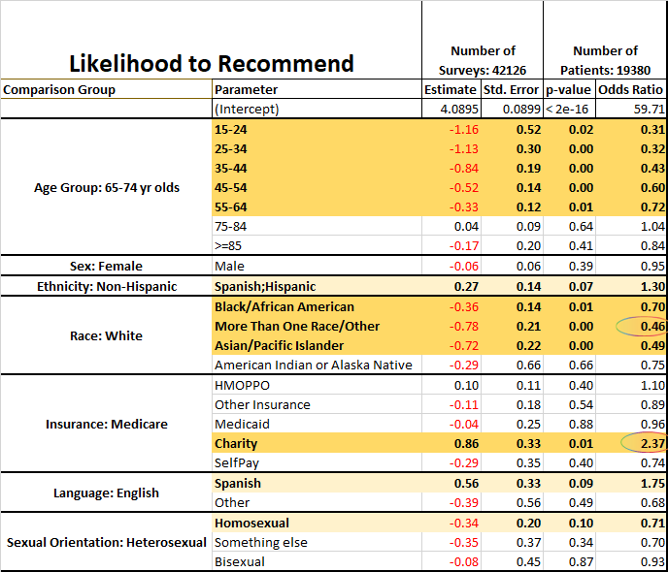
Those that are between the age of 15 and 64 are significantly less likely to give Top Box for LTR than 65–74-year-olds.
Those that identify their race as either Asian/Pacific Islander, Multiracial, and Black/African American are significantly less likely to give a Top Box score for LTR than those that identify as White. (More than One Race/Other is less than half as likely)
Those that received Charity were significantly more likely (2.37 times more likely) to give a Top Box for LTR than those that were on Medicare
Note:
Odds Ratio ≈ 1 -> as likely to choose Top Box as the comparison group
Odds Ratio << 1 -> less likely to choose Top Box than comparison group
Odds Ratio >> 1 -> more likely to choose Top Box than comparison group
Notes:
Add a legend, clarify the significant values on the table.

Slide 5
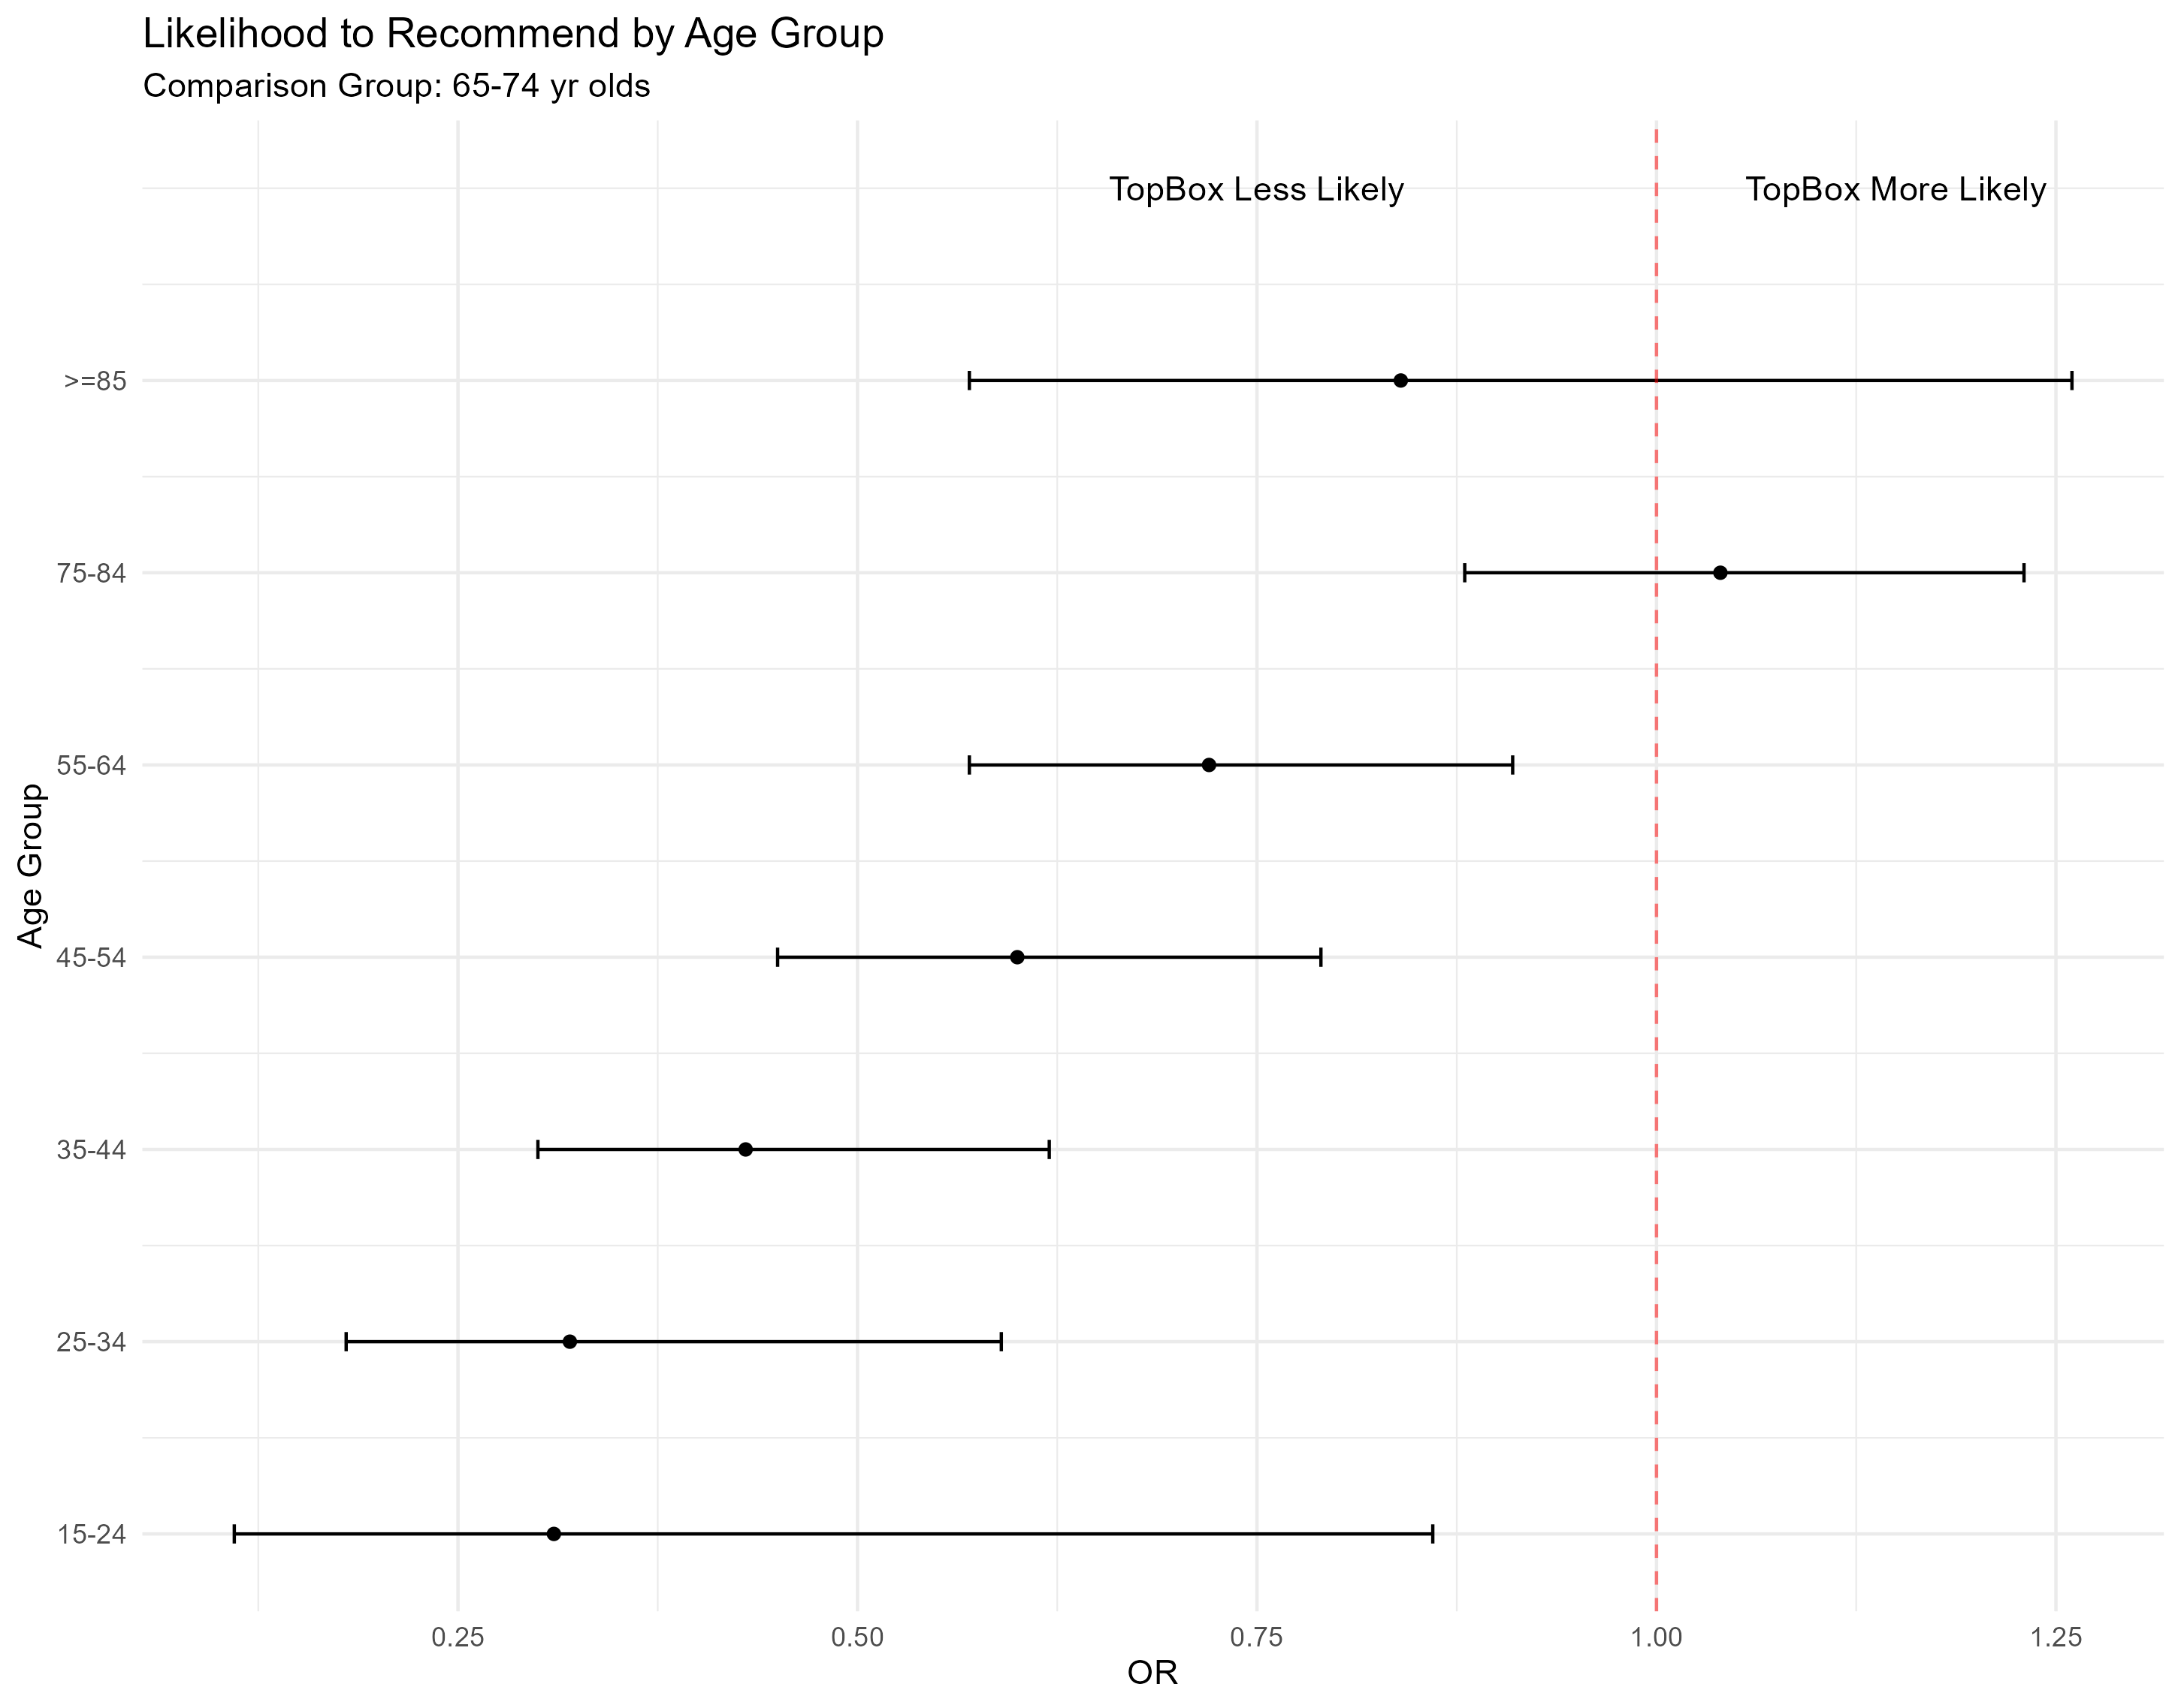
The chart displays the
95% confidence intervals for the odds ratios.
The dot on the line represents the odd ratio for the group.
Any group that crosses OR=1 does not indicate a statistically significant result.
For example: Those that are
>=85 are not statistically different from the comparison group 65-74 year olds.
35 – 44 year olds are significantly less likely to give a Top Box score than 65-74 year olds.

Slide 6
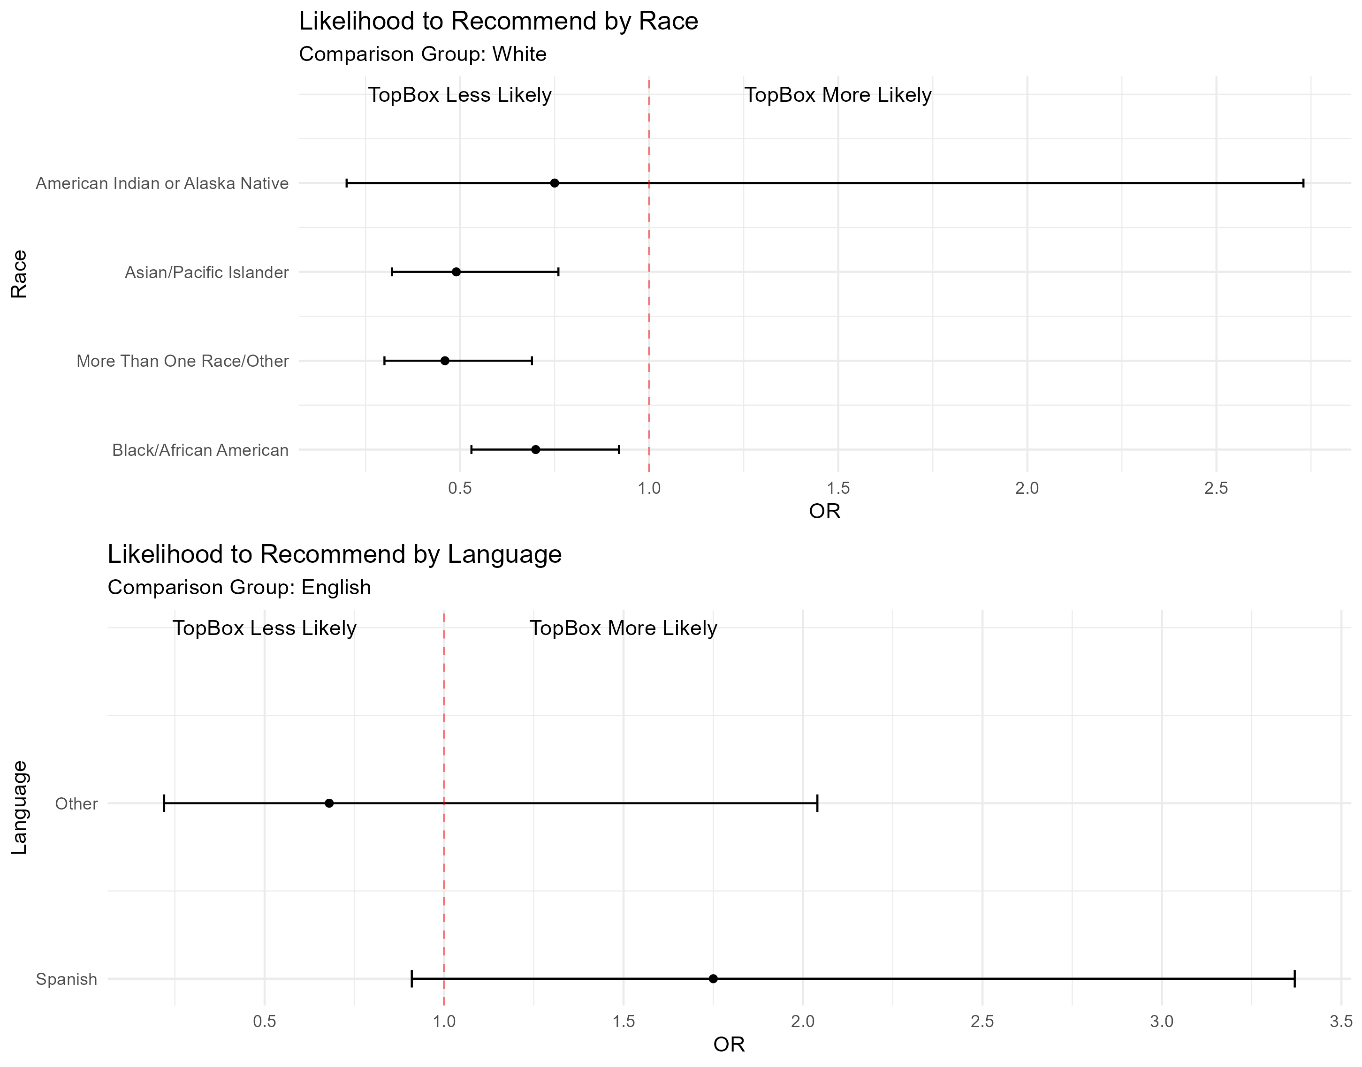

Slide 7
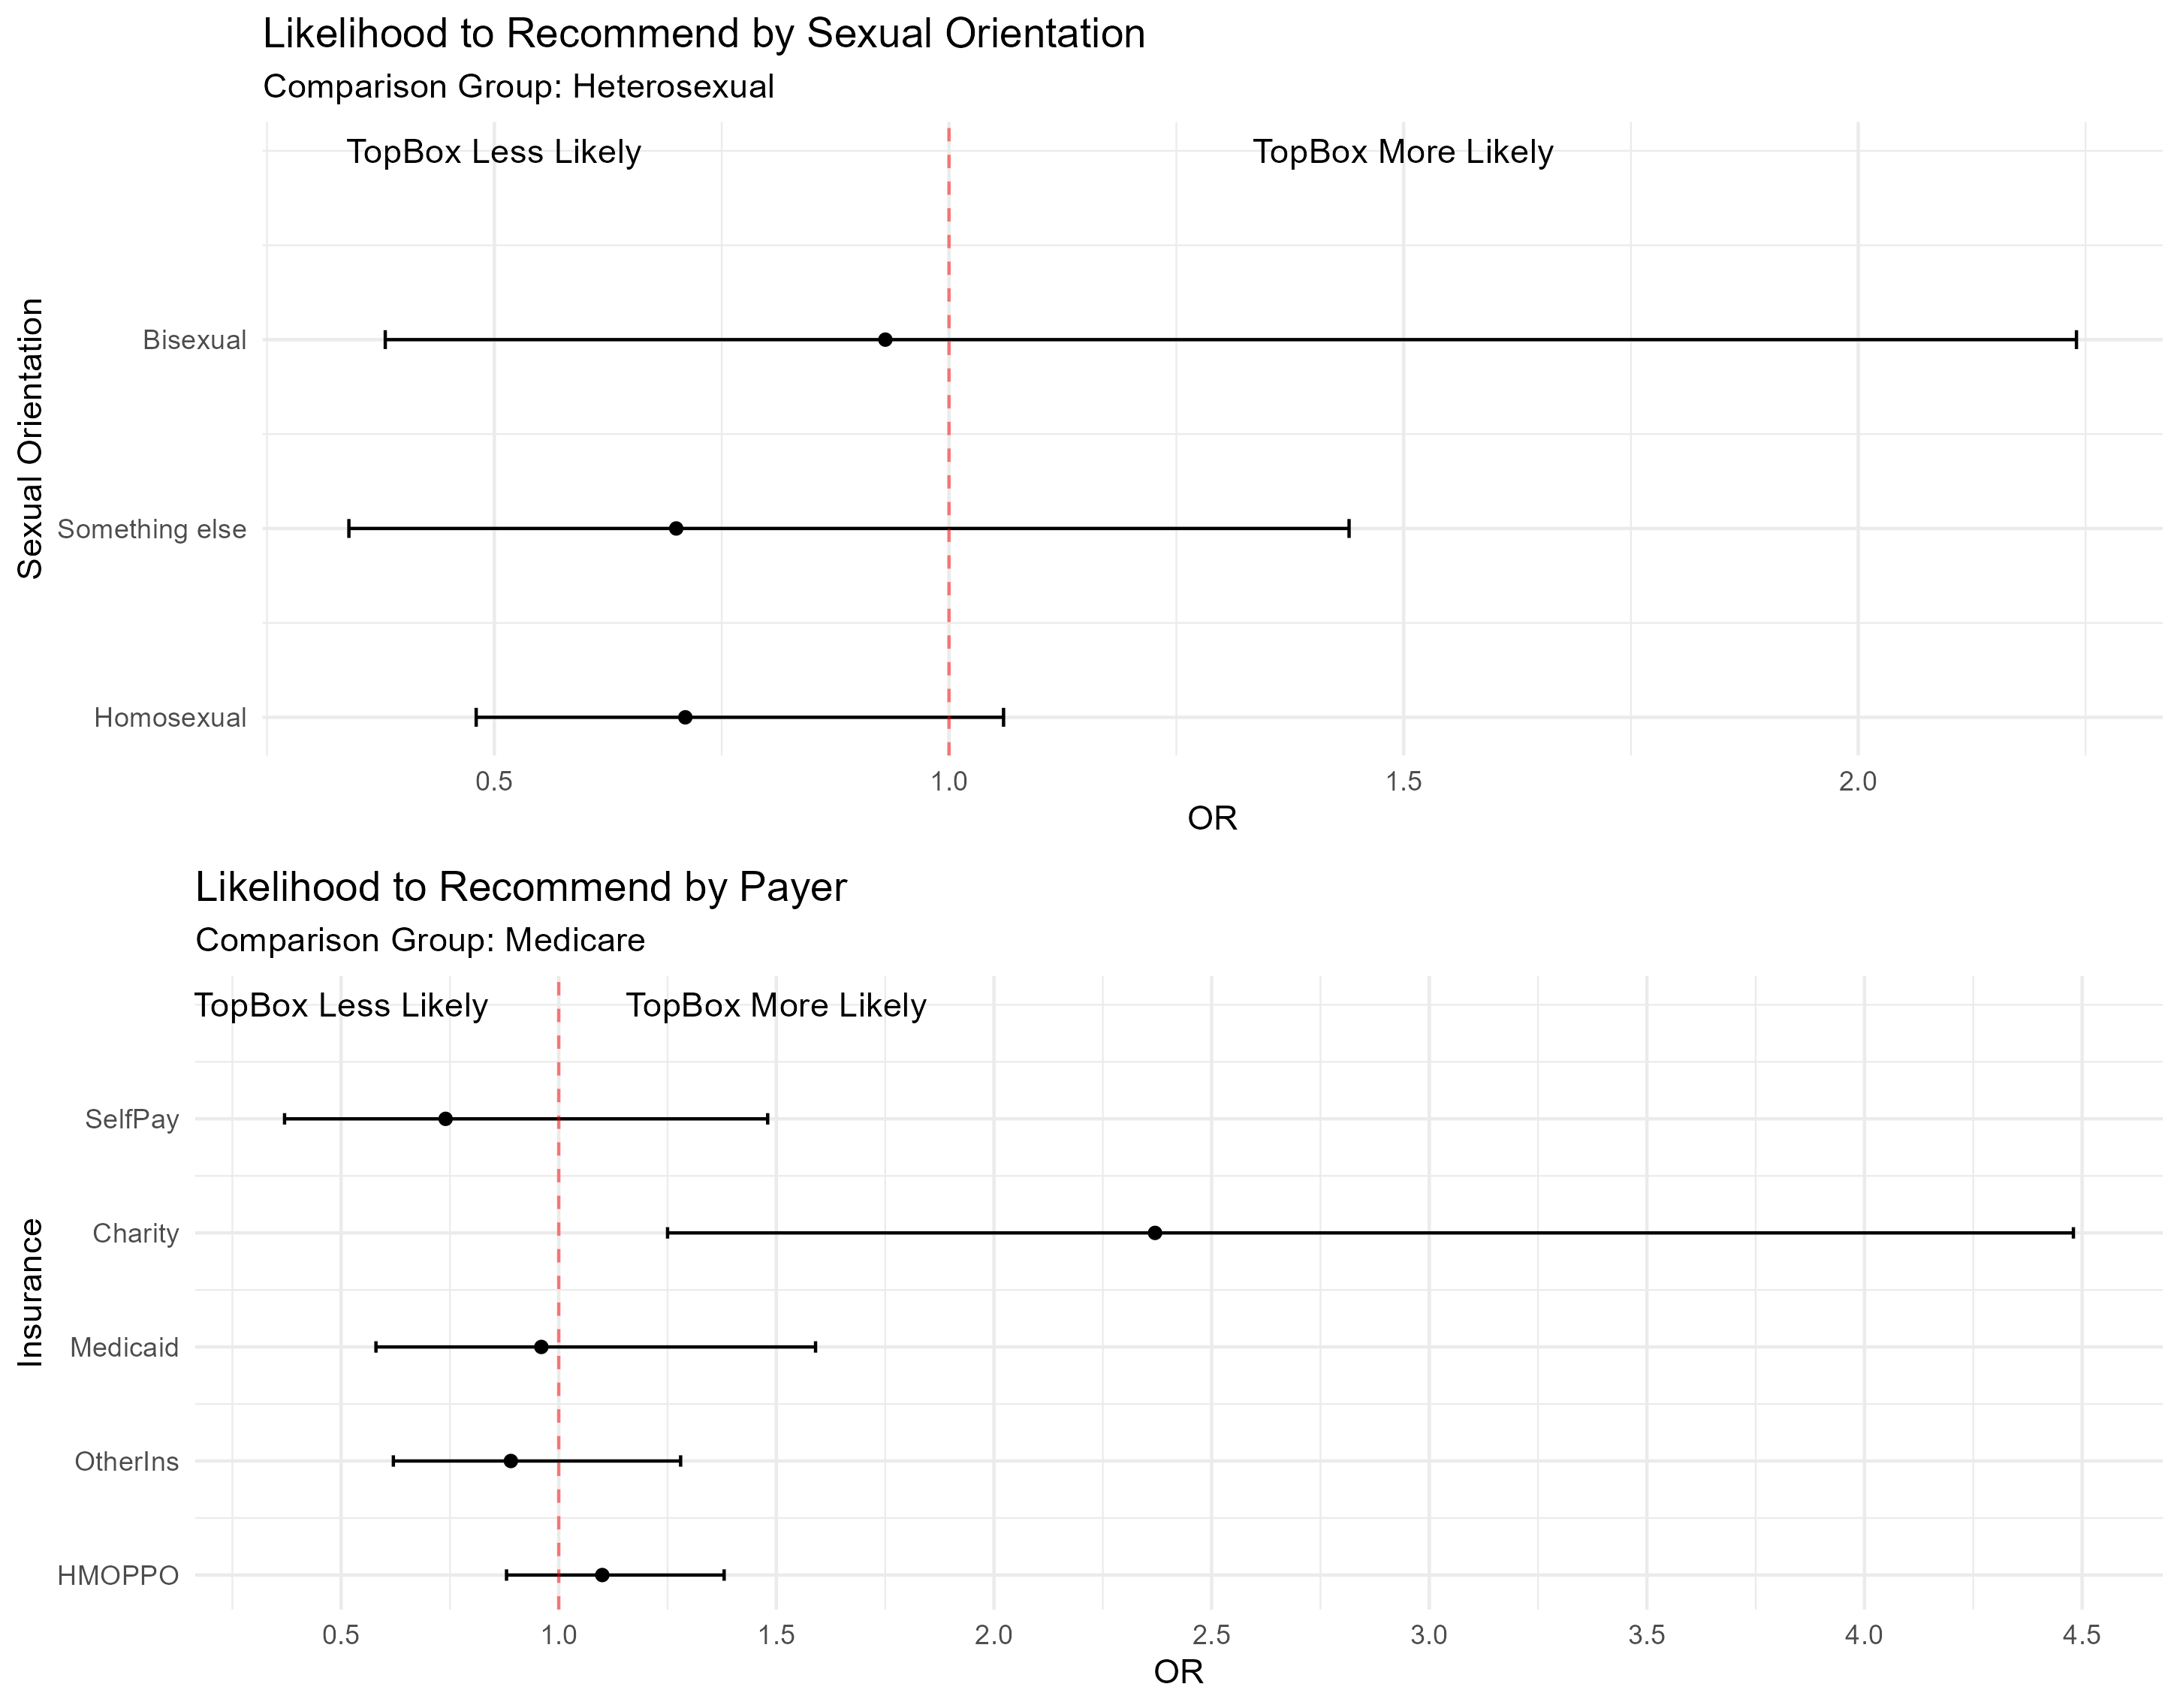

Slide 8
Those that are between the age of 25 and 64 are significantly less likely to give Top Box score for SWT than 65–74-year-olds.
Those that identify ethnically as Spanish,Hispanic are significantly more likely (1.32 times likely) to give TopBox scores for SWT than Non-Hispanics
Those that identify their race as either Asian/Pacific Islander, Multiracial, and Black/African American are less likely to give a TopBox score for SWT than those that identify as White.
Note:
Odds Ratio ≈ 1 -> as likely to choose Top Box as the comparison group
Odds Ratio << 1 -> less likely to choose Top Box than comparison group
Odds Ratio >> 1 -> more likely to choose Top Box than comparison group
.
Notes:
Add a legend, clarify the significant values on the table.

Slide 9
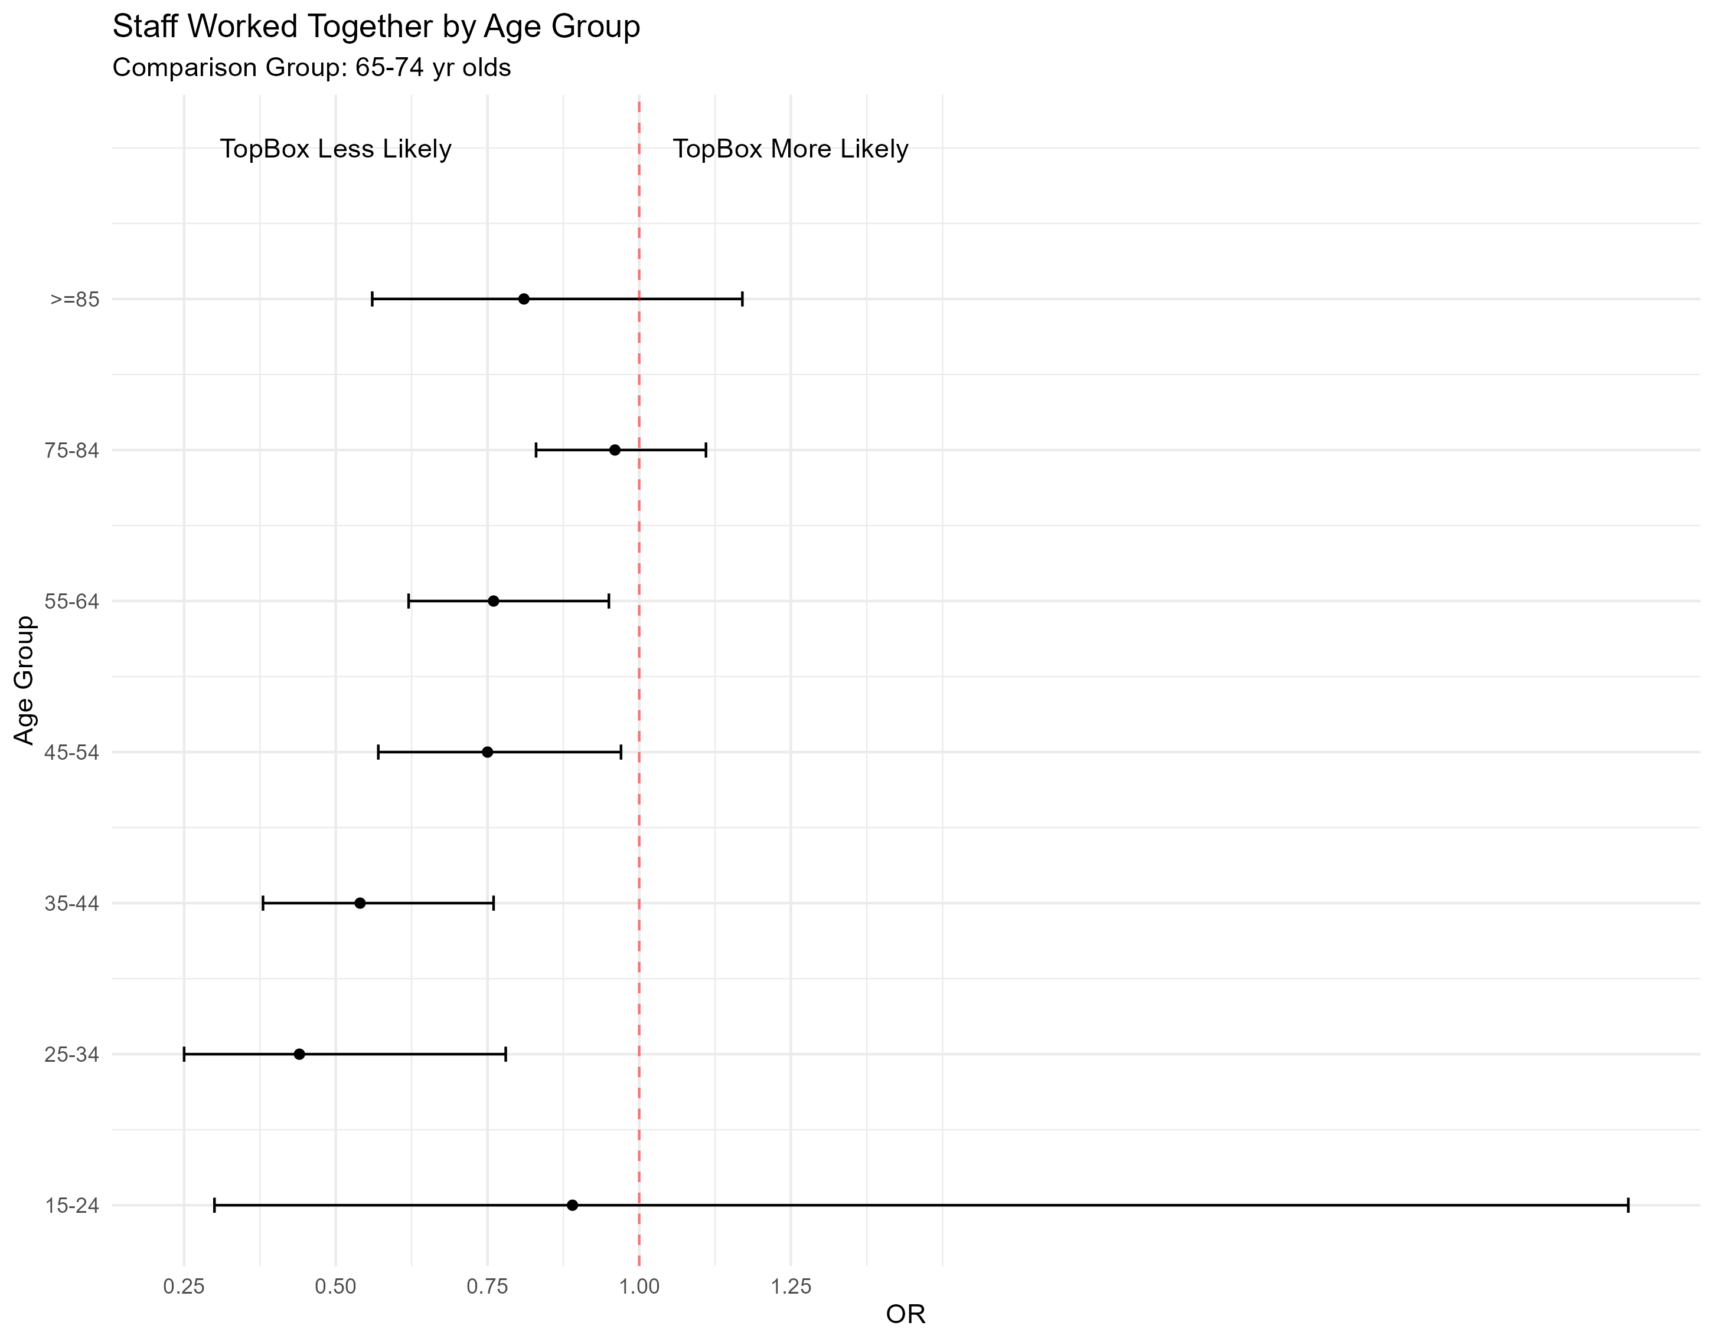

Slide 10
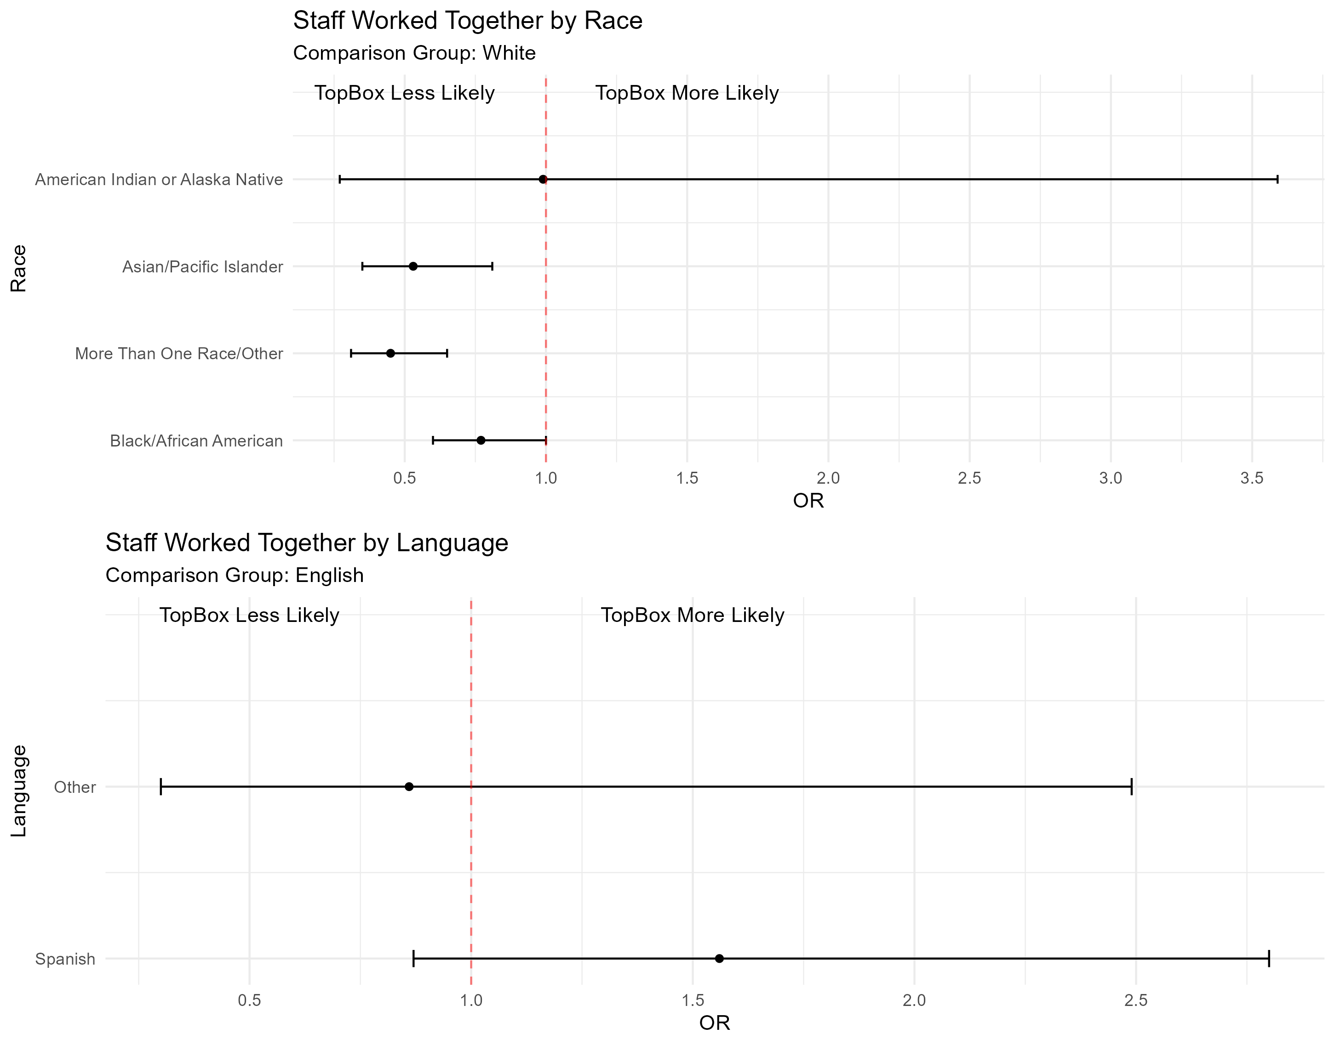

Slide 11
